Slide 1
How to install Anaconda Navigator? & JB
Premanand S

Slide 2
Introduction - Anaconda
Open source distribution of Python & R
Especially used for Machine Learning, Deep Learning, Data Science and still many…
Simplified package management & deployment
More than 300 data science packages
Desktop GUI
Most popular python distributor platform
Can install more than 1500 packages
Multiple data environments

Slide 3
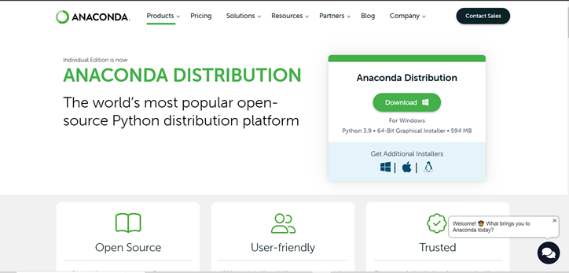
Weblink
https://www.anaconda.com/products/distribution

Slide 4
How to install Anaconda Navigator?
Google
Anaconda Navigator
Individual Edition – Option link
OS specific – Windows (Downloads)
Next – Next Steps
Start Menu – Anaconda Navigator
Jupyter Notebook – Opens with default browser

Slide 5
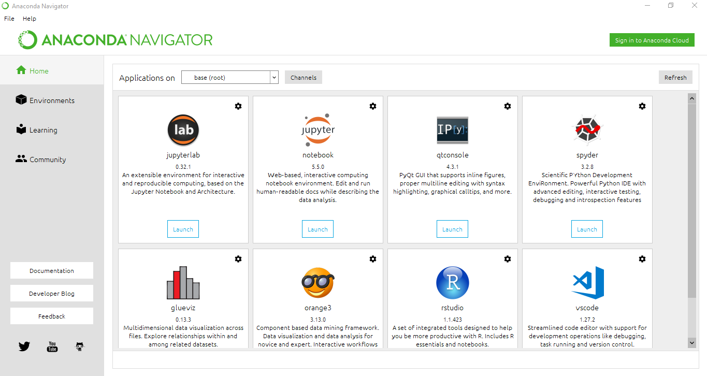


Slide 6
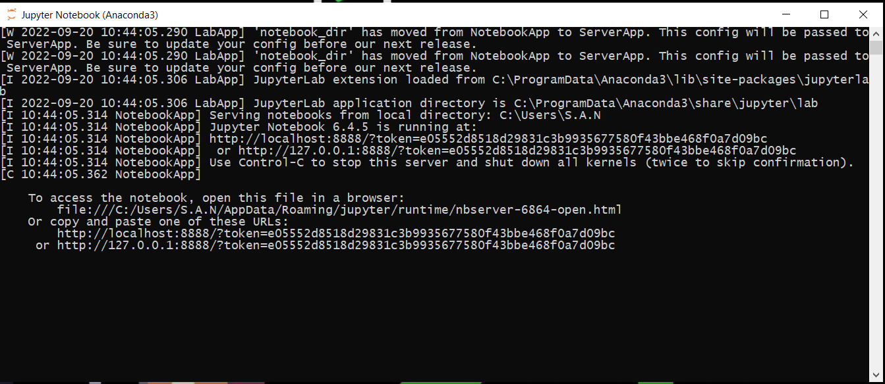
Don’t close this window

Slide 7
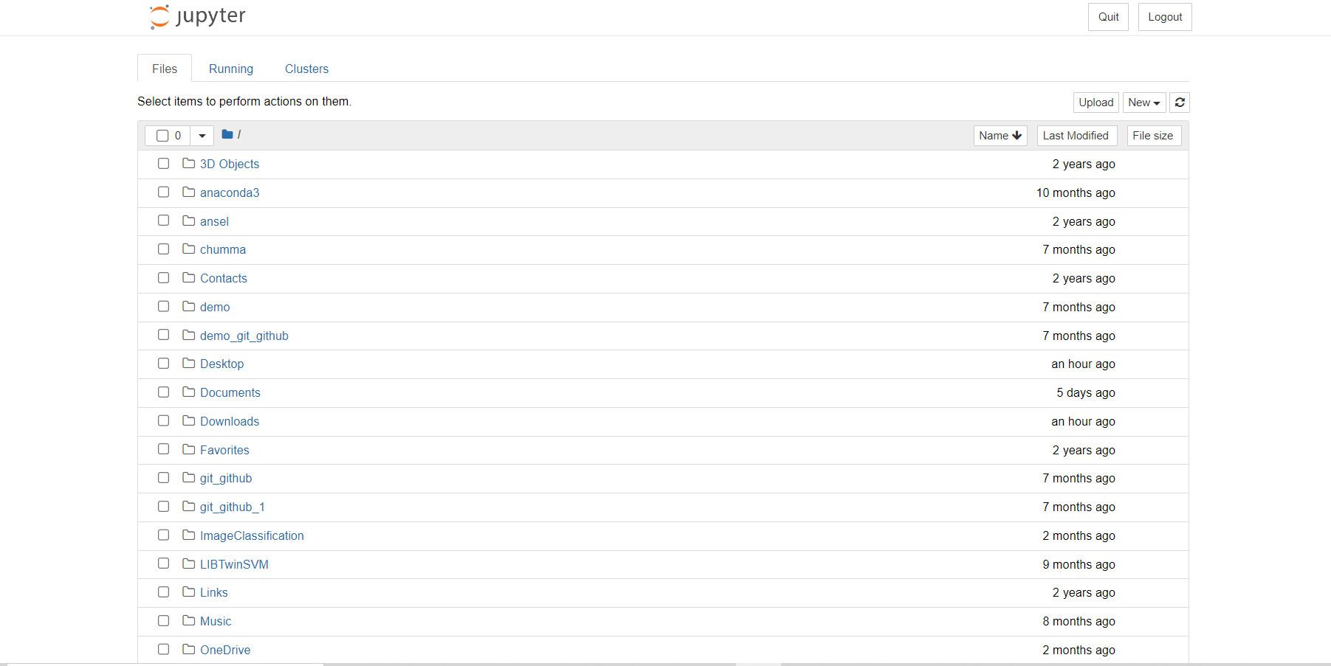

Slide 8
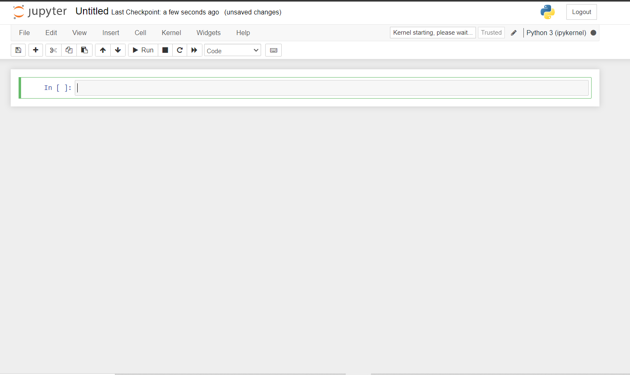

Slide 9
Jupyter Notebook
Open Source and Free
Web based computational NB – 2014
Local Network
Notebook – integrated code, Visualization, mathematical equation, Notes and also output
For better output understand
Supports 40 programming languages – Python, R and Scala
We can share it with mail, github or cloud

Slide 10
How to install JNB?
Pip – Python Package Manager (First need to upgrade pip – pip3 install –upgrade pip, then pip3 install jupyter)
Anaconda Navigator – Distribution Environment

Slide 11
How to open JNB?
Start menu – Anaconda Powershell – Jupyter notbook
Start menu – Jupter ananconda (Anaconda)
As it connects with OS .. Another dialog window will open .. Don’t close it

Slide 12
